Slide 1
Water Supply and access in Nigeria
GROUP 6:
Waheed amobi
Pamilerin olaiya
Tamara gray
Falana dayo
Romlah diamond
Odinaka julian
Chinoso chukwujekwu
Jimoh Azeez
Oluwatofunmi Akindele
Boluwatife joel

Slide 2
Research overview
This research explores the current state of water supply and access across Nigeria.
The focus area include but not limited to:
1) accessibility
2) Water quality
3) Treatment method
4) Health outcomes
Data was collected from urban and rural households across all six geographical zones.

Slide 3


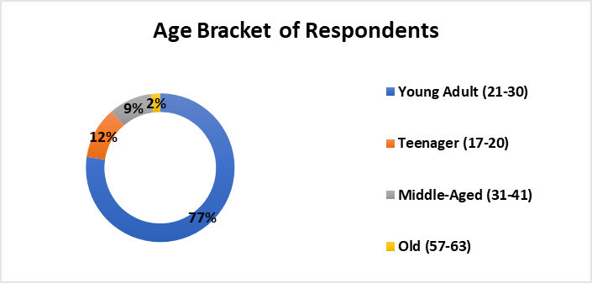
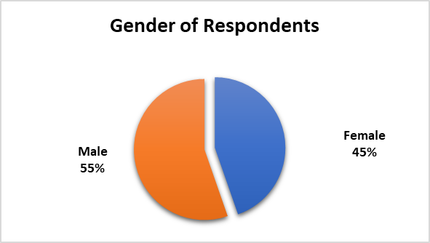
Demographic study
As stated previously, the study covered all six geo-political zones with a fair balance of male and female representation. Respondents ranged across young adults to the elderly where 77% of respondents were young adults and majority of the respondents were from the urban area.

Slide 4
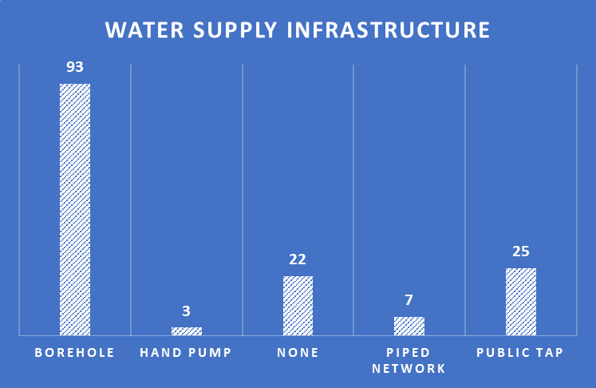
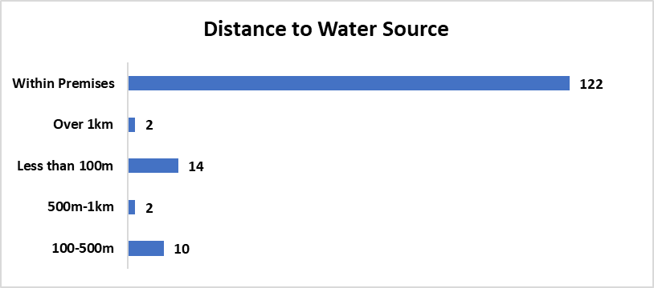
Water accessibility
The main source of water supply is from a borehole with 93 respondents indicating that they use a borehole for their water supply. Furthermore, most respondents shared that they indeed had access to water on their premises with this being answered by 122 persons.

Slide 5
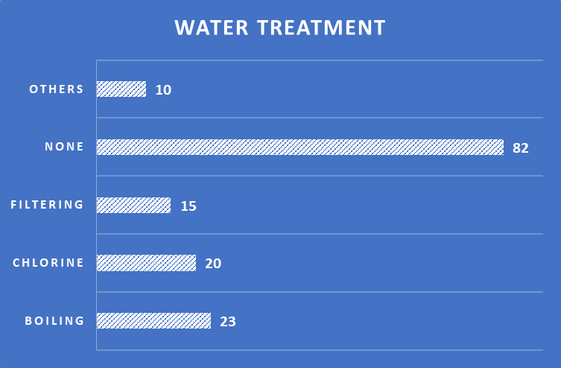
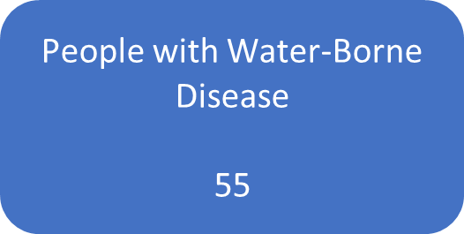
Water quality and treatment
Unfortunately, not all the respondents have access to safe sources of water. Treatment practices such as boiling, filtration and chlorine are common but many still do not treat their water – this is indicated by 82 respondents with 55 persons indicating having experience a water-borne illness.

Slide 6
insights
Households using unsafe water are more likely to treat it, but not all persons do.
Younger respondents are less likely to treat their water consistently while older age group may tend to be more cautious.
Southwest and north central shows better access to safe water (more boreholes and piped connections).
Chlorination is more common in North central and south west.

Slide 7
recommendation
Invest In safe water infrastructure (especially in the rural areas)
Promote low-cost water treatment methods.
Launch community education campaigns on water safety.
Target zones with high illnesses for intervention.
Encourage policies supporting piped and borehole access.

Slide 8
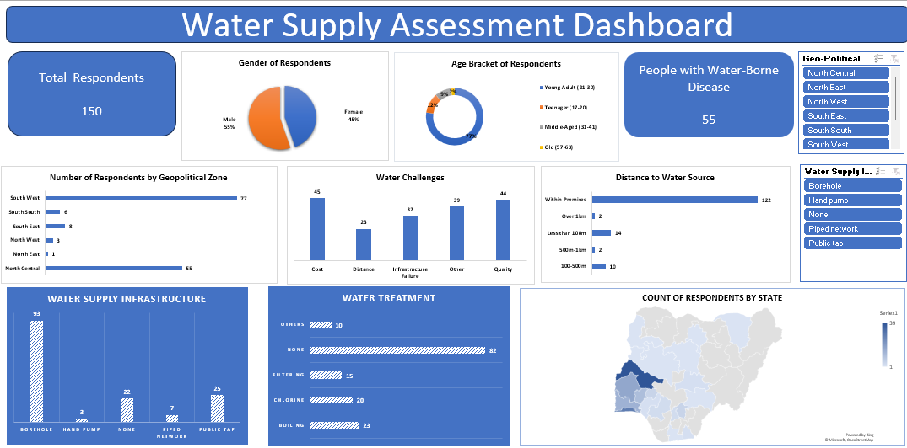
Water supply and access dashboard Nigeria

